Slide 1
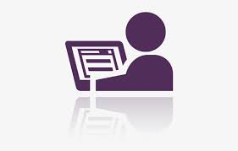

Slide 2


PROJECT EXHIBITION (DSN2099)
REVIEW I
TEAM NO.100
PATIENT
DASHBORAD
Dr. Vikas Panthi (Guide )
Dr. Anand Motwani (Project Coordinator)

Slide 3
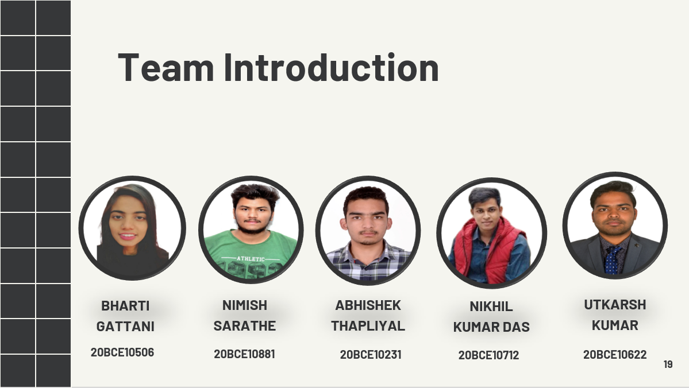


Slide 4


Slide 5

The Patient Dashboard is the first screen that displays when you access a patient’s record and is a great tool for creating a single location for displaying data you view on a regular basis.
If you are a first-time ClinicalConnect user, the Dashboard will be empty. You will need to populate the dashboard with clinical modules according to your clinical needs. Drag and drop the module icons found in the Patient Dashboard Header to add modules to your dashboard. The Patient Dashboard can also be accessed at any time by clicking the Dashboard: Patient option from the Clinical Modules menu.
INTRODUCTION
CONT…

Slide 6
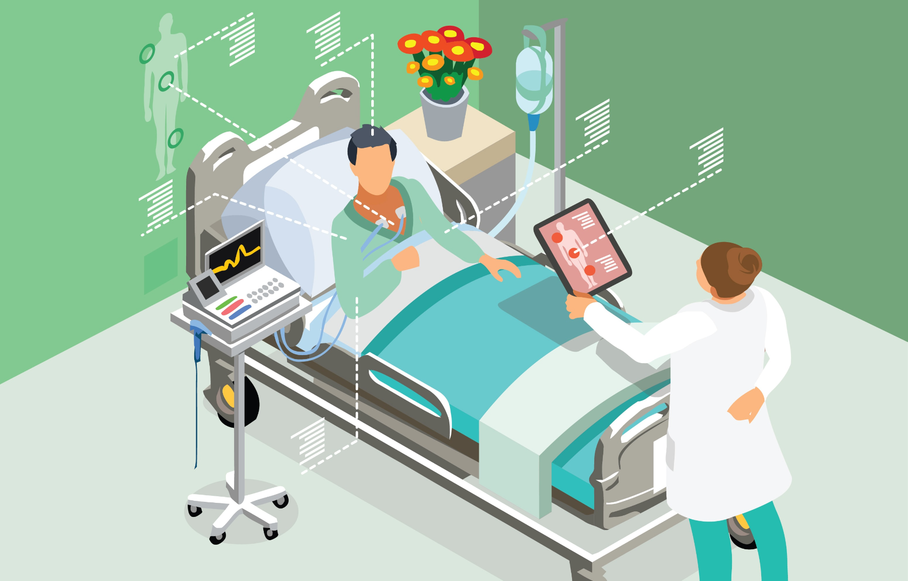
An interactive dashboard using Python(Streamlit, numpy , pandas) to easily collect and show all the details of a patient saved across various datasets in one place. This can help the patients and their caretakers to easily access the data regarding patient and take better care of them.

Slide 7

OBJECTIVE
The objective for the project is that many people in the world cannot easily access medical facilities majorly due to large distance from the hospitals.
This acts as a hinderance in their improvement and regular visiting of nurse is not a feasible solution.To resolve this issue we can use IoT enabled monitoring implants which can log the patient vital changes in the remote database server of the hospital.

Slide 8
LITERATURE REVIEW
During pandemic situation when everyone was asked to stay at homes, people were travelling to hospitals for regular checkups, medical tests and reports. Visiting hospital is very risky during a pandemic and people are highly prone to get infected by virus. So in such cases people can get their reports sitting at homes. Furthermore one can easily access all test reports at one place and are not required to keep hardcopies of reports.These reports can be accessed anytime from anywhere.

Slide 9
Proposed Work And Methodology
While there are many different healthcare dashboards, each is an analytical, comprehensive, and dynamic tool that provides a condensed, visual report of key performance indicators (KPIs). Presenting metrics in such a manner makes it easier to understand progress and challenges, and gives a high-level snapshot of what’s going on in your facility.
Healthcare dashboards aren’t as publicly visible as dashboards in other industries because of the need to protect patient information. But that doesn’t mean your healthcare organization should avoid them—quite the opposite. Executives, managers, and clinicians within hospitals and health systems rely on dashboards to provide critical information to inform data-driven decisions, without sacrificing data privacy.

Slide 10
REAL TIME USAGE
While many hospitals keep their data close to the vest to protect patient privacy, we were able to find two great dashboard examples in healthcare that your facility can learn from:
#1: Virginia Commonwealth University Health System (VCUHS)
VCUHS implemented a clinician safety dashboard to address issues of preventable medical errors. In short order, the dashboard proved its worth by helping the health system meet its goal of having zero events of preventable harm. It also helped improve other metrics, such as vaccine administrations, infection and fall rates. The dashboard was successfully adopted by nurses, care partners, and physicians, reducing their reliance on memory by providing a wealth of information in a central location.
#2: Rush University Medical Center
Rush uses a surgery outcomes dashboard. Similar to the clinician dashboard, this tool highlights departmental operations to evaluate performance. Looking at the dashboard, it’s easy to see how Rush benchmarks against other providers and the entire industry. This provides valuable perspective—numbers without context can mean very little.

Slide 11
Hardware And Software Requirement
•Minimum CPU or processor speed-1GHz
•Minimum GPU or video Memory – 1GB
•Minimum system memory (RAM)-2 GB
•Minimum free storage space- 1GB
Audio hardware(sound card, speakers etc.)
Hardware
Software
VS code,
Heroku,
Pycharm,
Azure,
Docker File,
Numpy,
Pandas,
Streamlit.

Slide 12
Overall Architecture Diagram
The diagraming library provides components for a number of different providers. The following will likely be most relevant for most use cases out of the 14 available.
AWS/GCP/Azure — These providers expose the official cloud service assets that you would be using for any diagram that leverages one of the main cloud providers. My team mostly works in GCP, and I would spend hours building these diagrams manually before stumbling across this library so I was a bit excited when I discovered I had these node assets at my fingertips.
Generic and On-Premise — These nodes will likely be used together in the case that you want to illustrate the underlying technologies in a cloud agnostic way. For example supplying an architecture with a Beam component over display Google DataFlow.
Frameworks — These components will be useful if you want to illustrate a node with a programming language.

Slide 13
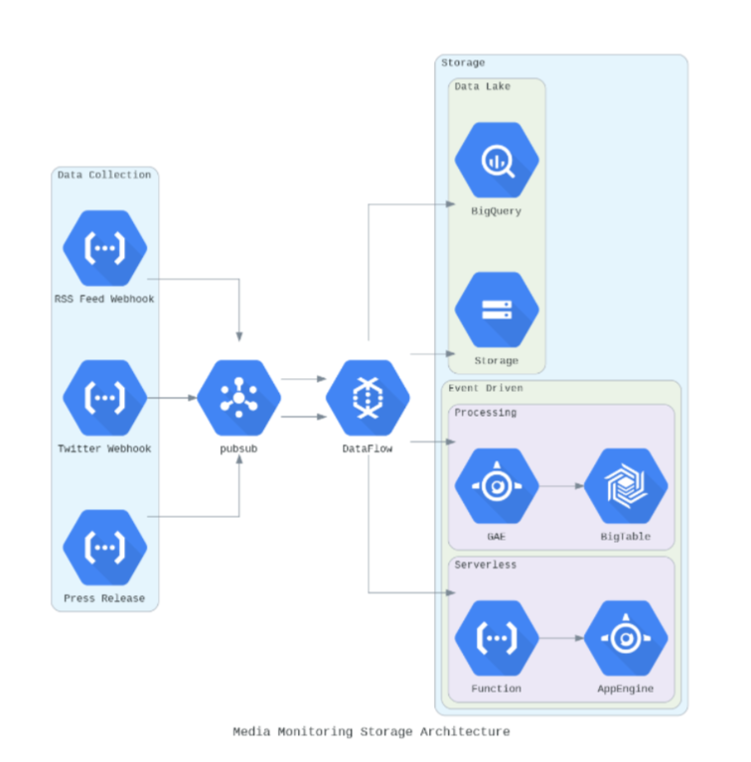
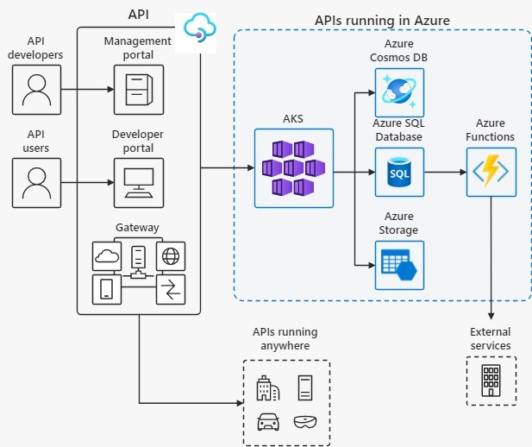

Slide 14
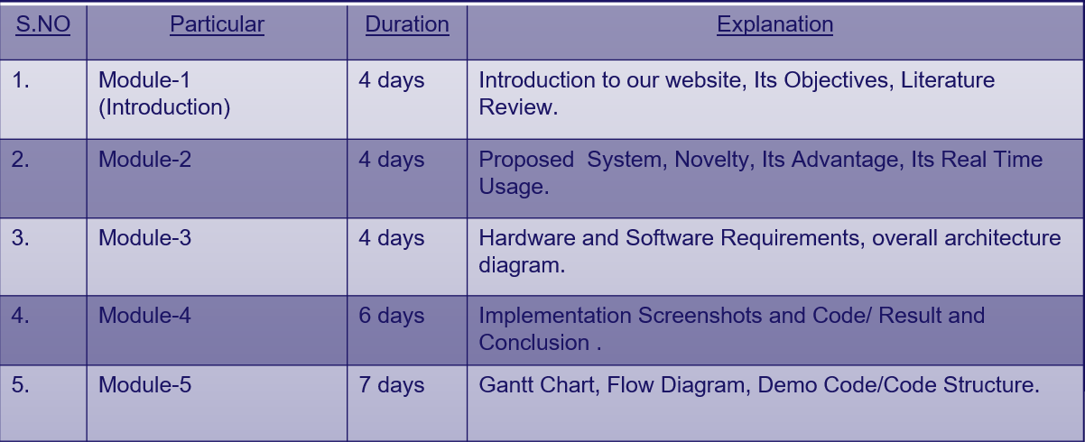
Module Split-up / Explanation

Slide 15
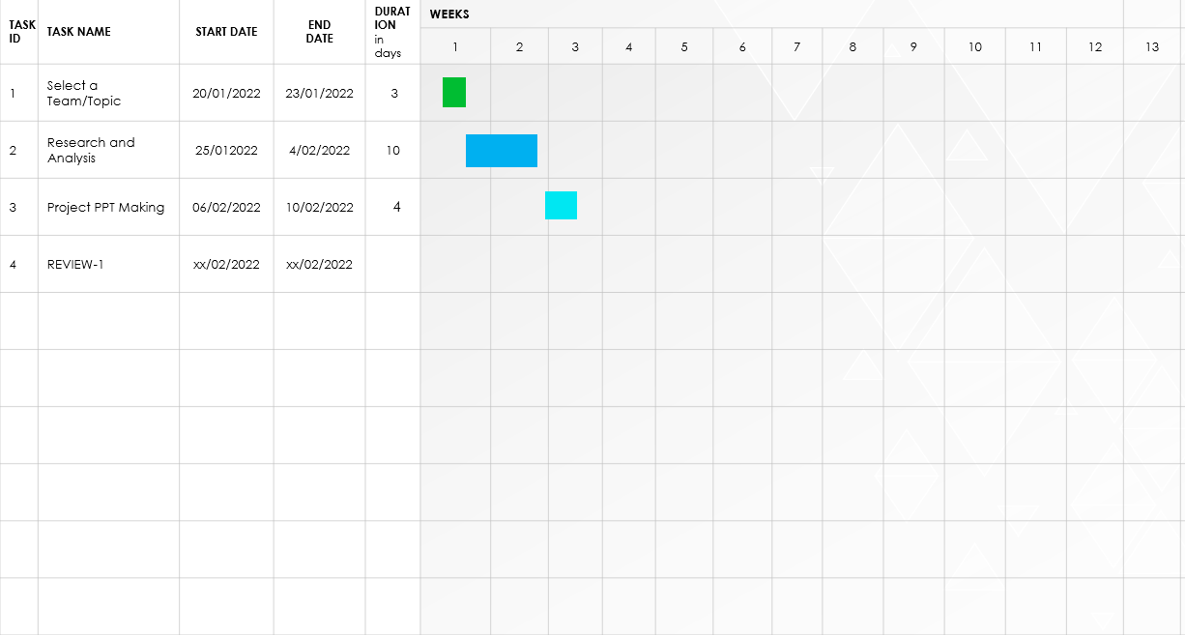
Project Timeline Chart

Slide 16
Conclusion
While there’s no end-all, be-all healthcare dashboard template, there are common types of dashboards your facility can put into play to aid strategic decision-making. As long as your dashboards aid in comprehension and analysis of the big data flowing through your system, you’re headed in the right direction.

Slide 17

References
https://www.udemy.com/course/the-complete-guide-to-angular-2/
https://medium.com/dsc-vit-bhopal/how-the-internet-works-http-concept-a5c08b4234b2
https://getbootstrap.com/docs/5.1/getting-
https://medium.com/dsc-vit-bhopal/how-the-internet-works-http-concept-a5c08b4234b2
https://www.geeksforgeeks.org/web-development
https://rapidapi.com/hub
https://www.boldbi.com/dashboard-examples/healthcare/patient-monitoring-dashboard

Slide 18


